Slide 1

OMG! WTH Do I Start with A11y?
Meryl K. Evans

Slide 2
Slides and Resources
Meryl.net/wcsc

Slide 3
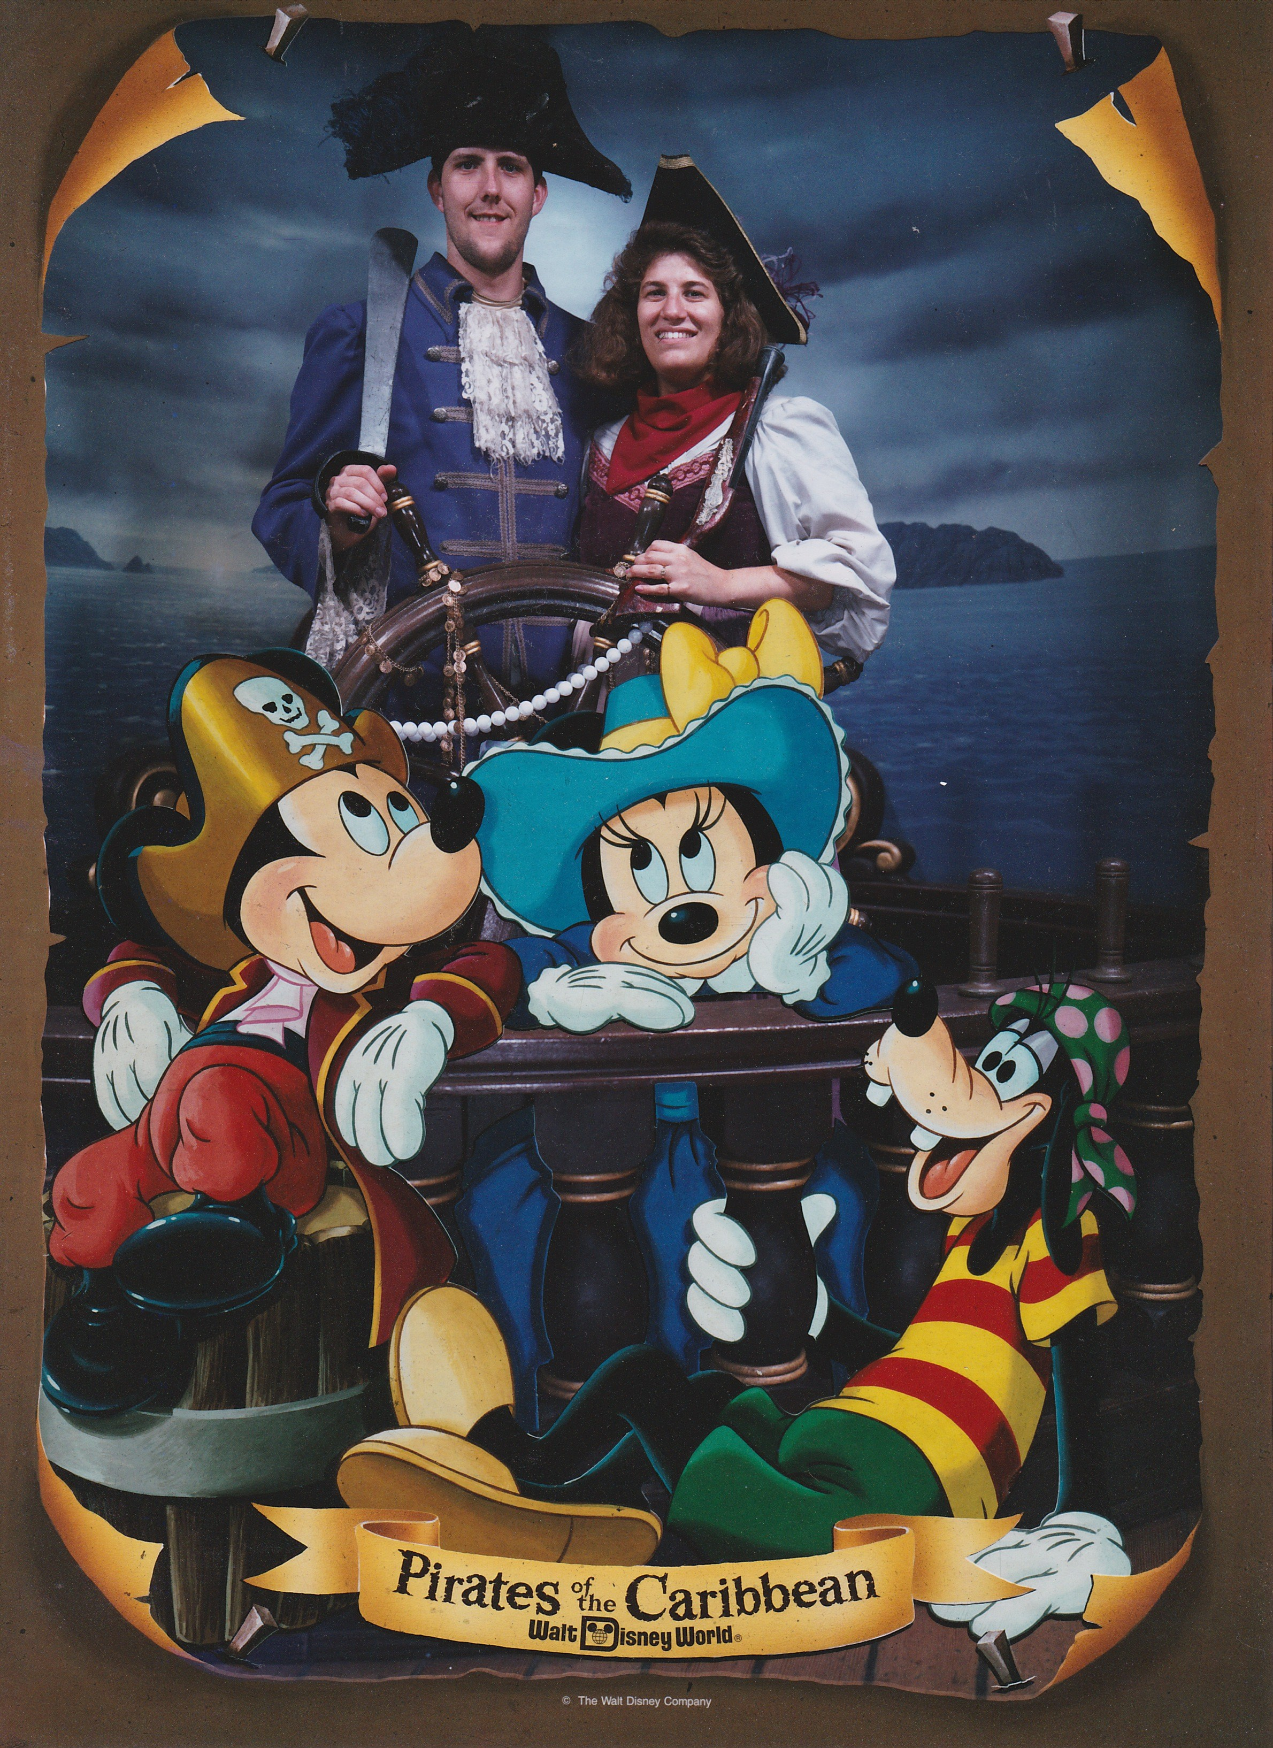
Howdy, I'm Meryl
She / her
Native Texan 🤠
Deaf since birth
Caption Pusher
Digital marketing

Slide 4
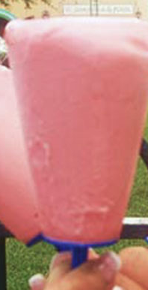
Takeaways
Why accessibility matters
Where the heck do I start with #a11y?
How to create accessible content
WordPress accessibility features.
Image credit:
Guide to Six Flags Over Texas

Slide 5
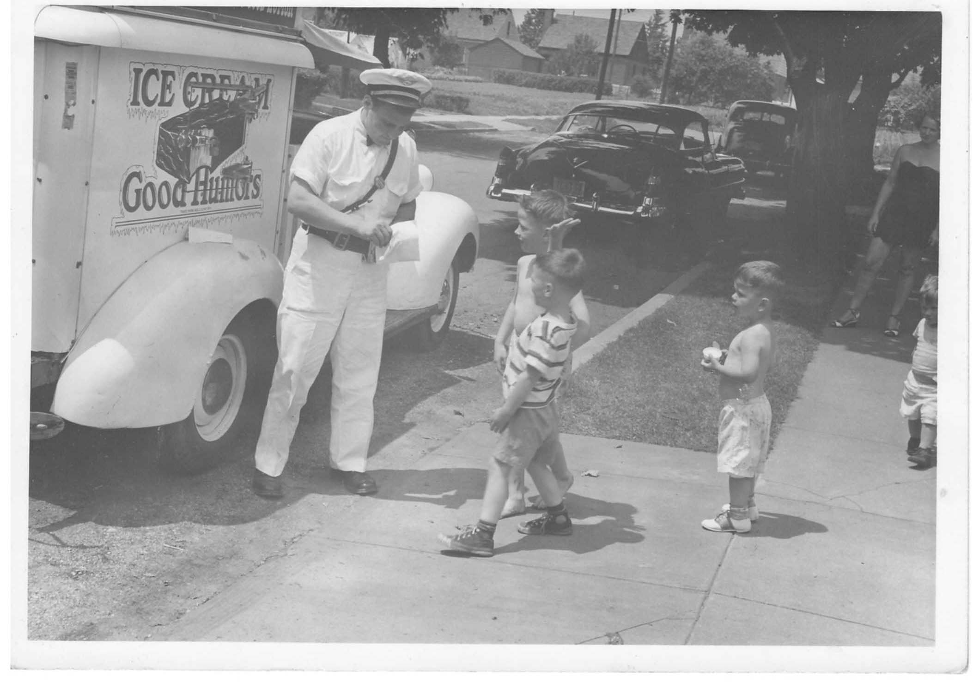
Curb Cut Effect

Slide 6
Why Is Accessibility Worth it?
Equitable
Content choices
Search engine benefit

Slide 7
Beyond the Curb Cuts
Others use accessibility
Non-permanent impairments
Temporary
Situational
Episodic
Aging

Slide 8
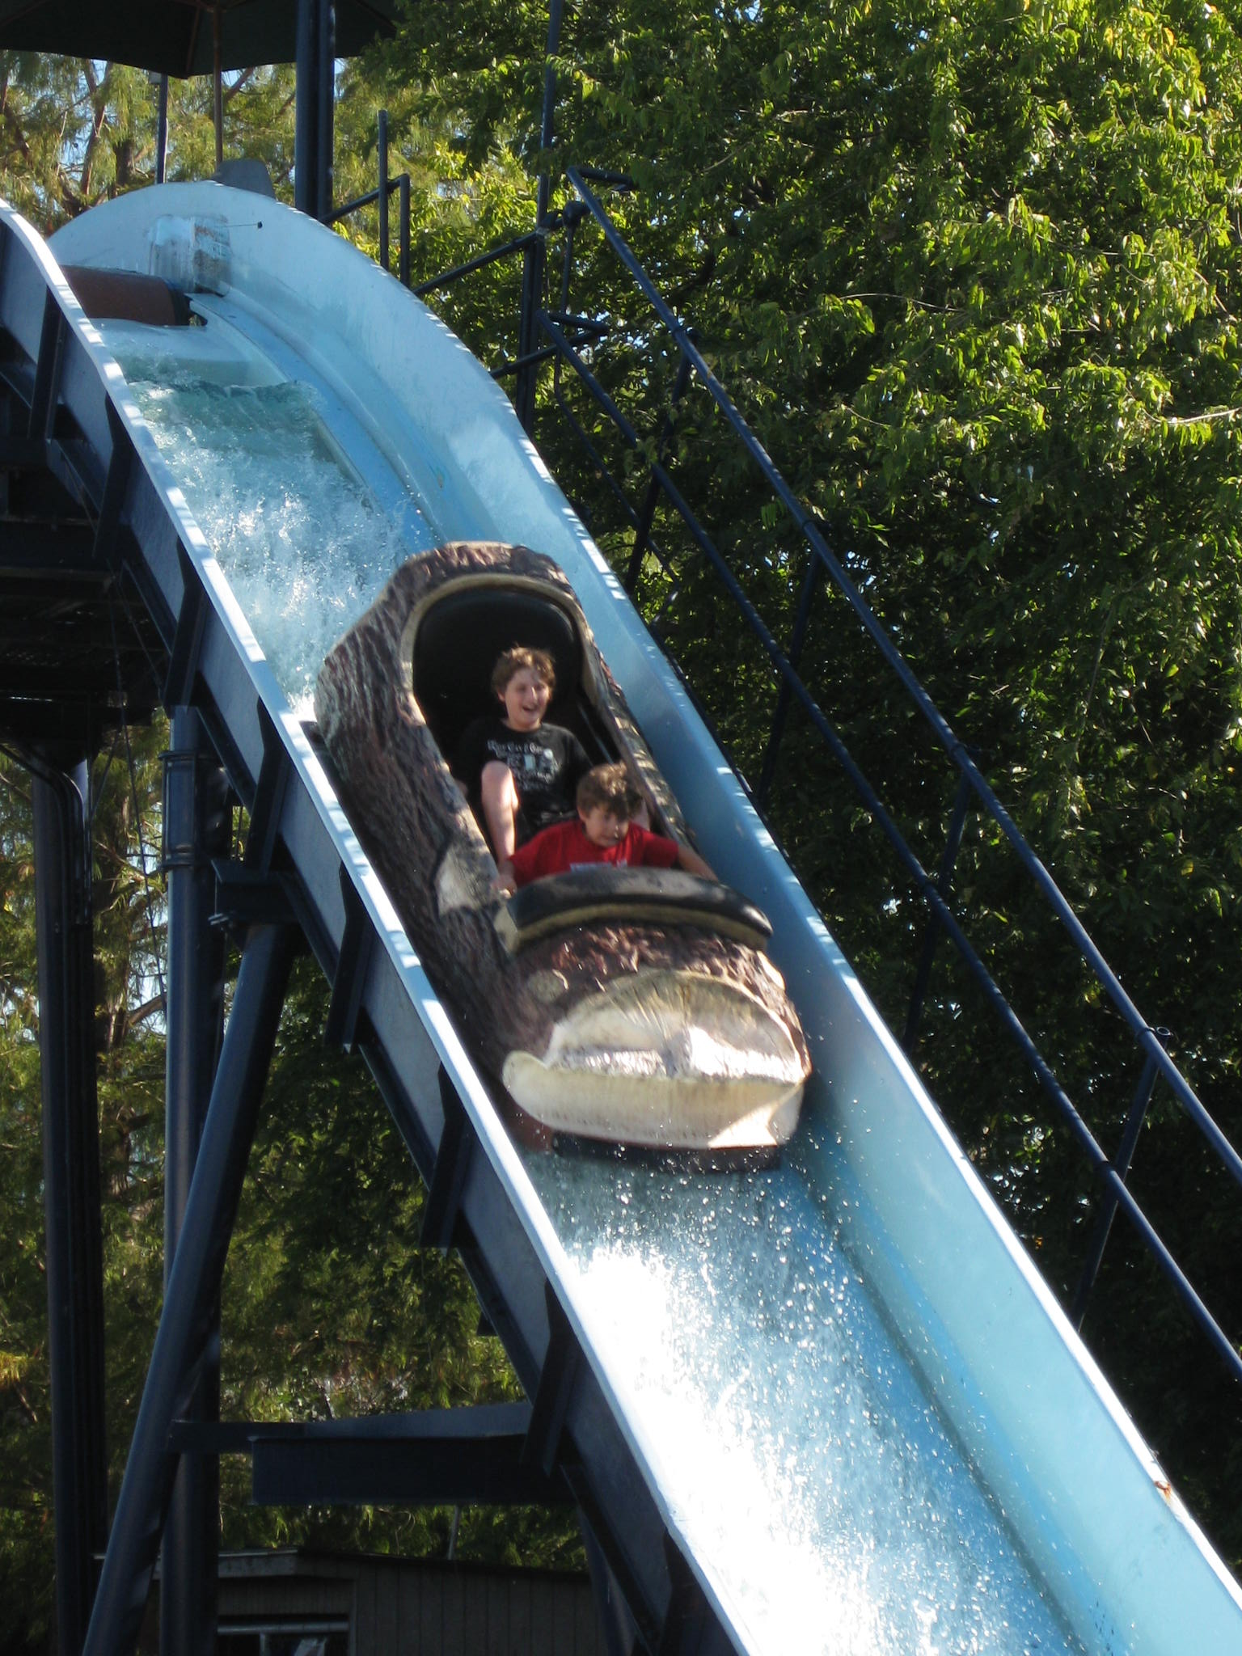
My Accessibility Roller Coaster Story
Accessibility conference
WCAG?! ARIA!? Help!
Marketing skills
Learning and sharing

Slide 9
Progress not perfection

Slide 10
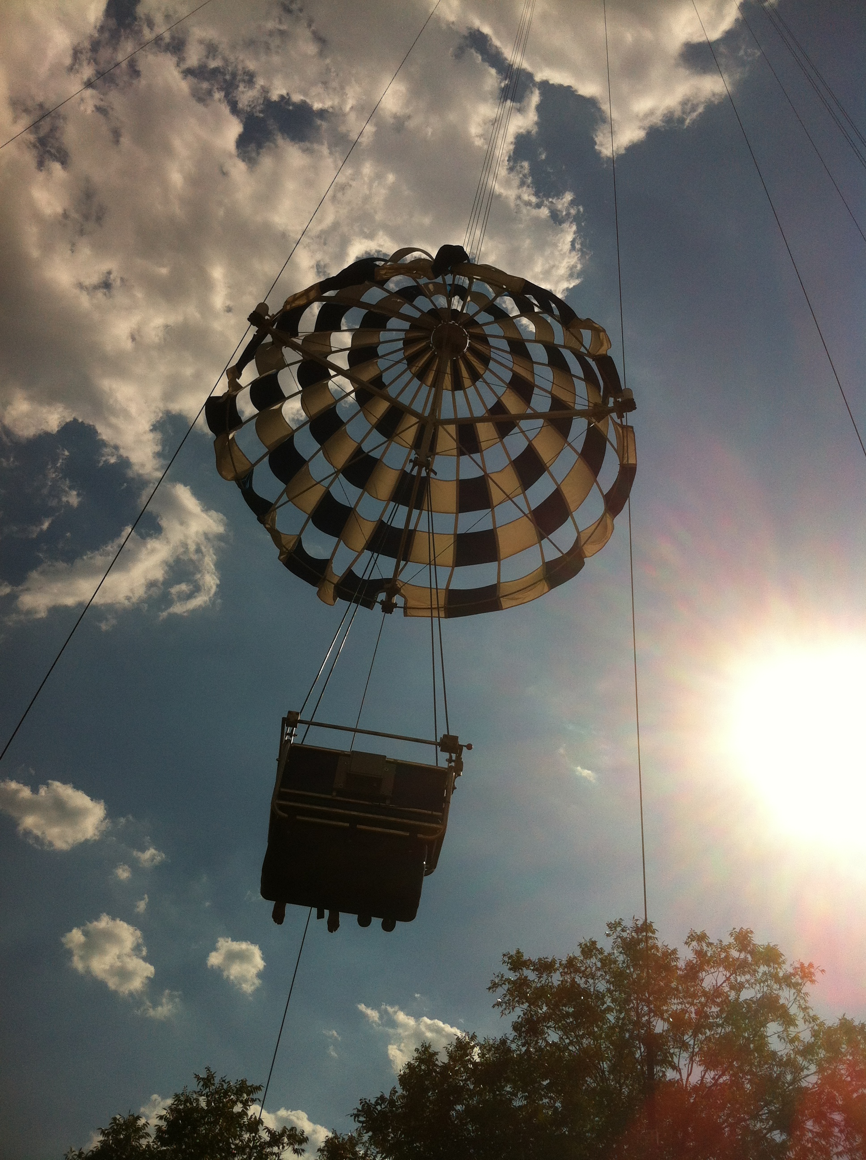
Alt Text for Images
Start simple
Pick one thing
Add alt text

Slide 11
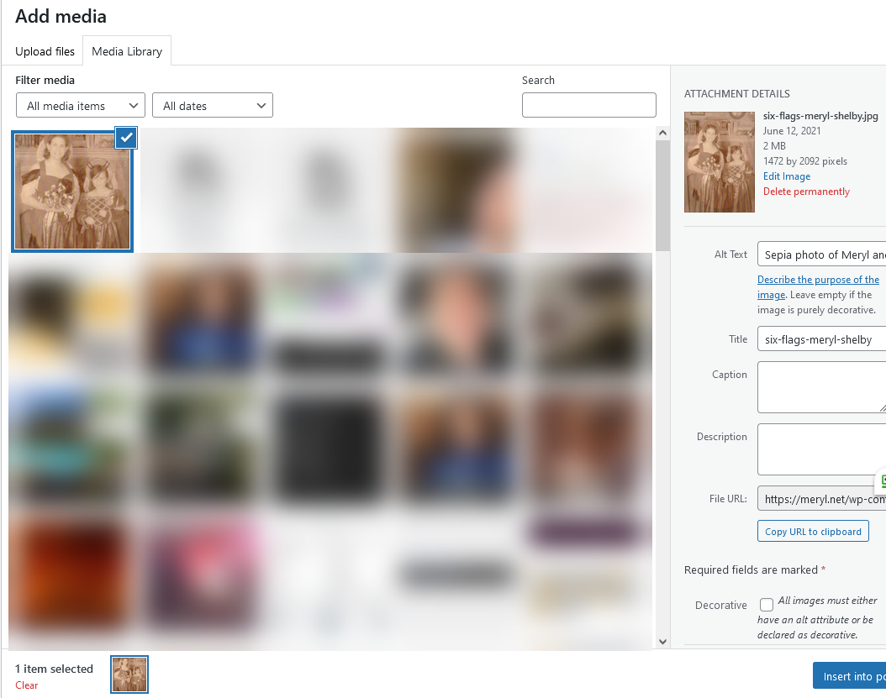
Alt Text on WordPress

Slide 12
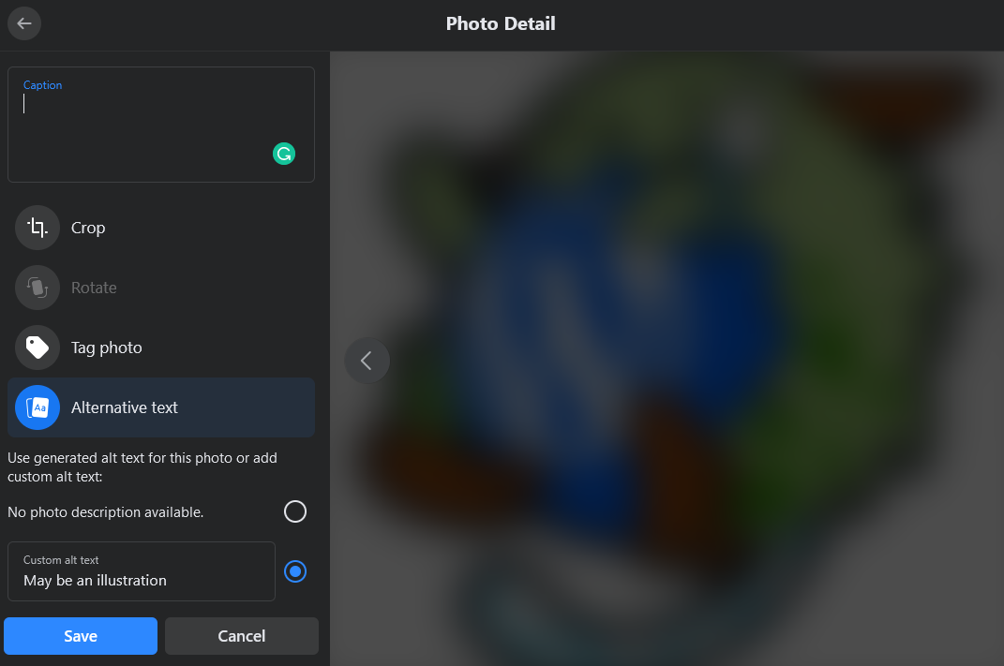
Bad Automatic Alt Text
May be an illustration.

Slide 13

Alt Text: Accessipuu
WordCamp Santa Clarita's a11y Wapuu, Accessipuu containing light green fur, dark green dots, and a polka dot sky blue tail, and fangs.

Slide 14

Alt Text: Bleepuu
Illustration of Bleepuu, parent to Accessipuu, last seen around 1972 at Magic Mountain amusement park in the Santa Clarita Valley.

Slide 15
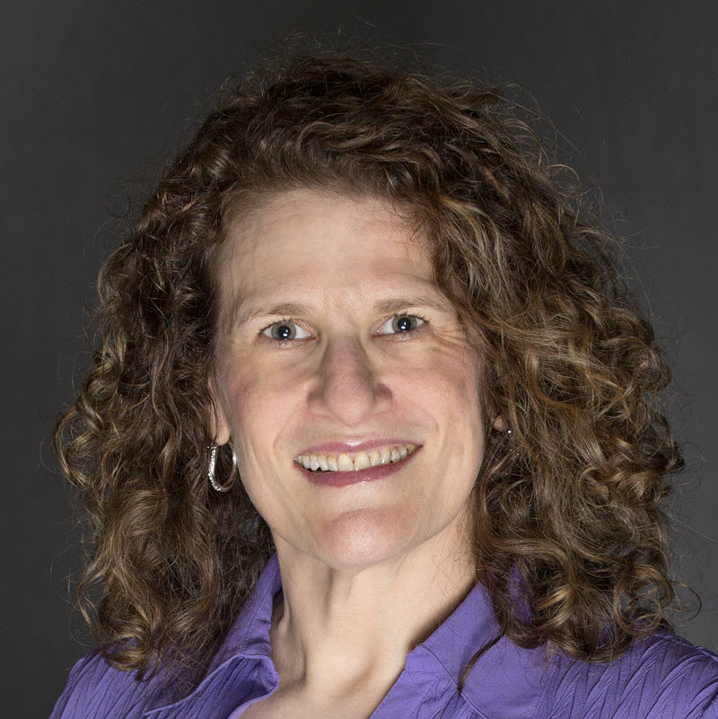
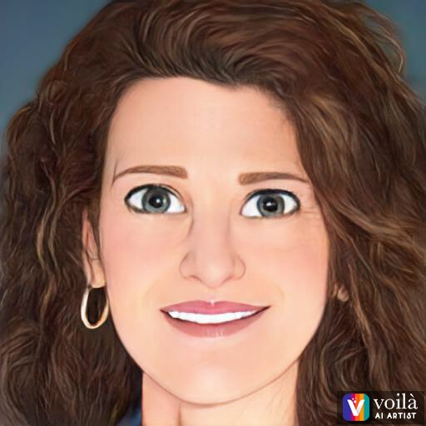
Good Alt Text
Descriptive yet concise
What's relevant?
Skip "This is an image or GIF of"
Decorative

Slide 16
Linked Images
Treat as link first, not images
Logos
Location
Purpose of link

Slide 17

Caution! Animated GIFs
Seizures
Migraines
Vertigo
Distraction
Image credit: Pixabay

Slide 18
Emojis: Love — Hate
🙏
A
😄
B

Slide 19
Thankfully 🙏 I 🙏 never 🙏 do 🙏 this.
Notes:
Put at end of content

Slide 20



<title>Title Tag<title>

Slide 21
Outline
A. Fruit
1. Apples
2. Oranges
B. Vegetables 1. Broccoli
2. Carrots

Slide 22
<h1>Headings</h1>
<h2>Fruit</h2>
<h3>Apples</h3>
<h3>Oranges</h3>
<h2>Vegetables</h2>
<h3>Broccoli</h3>
<h3>Carrot</h3>

Slide 23
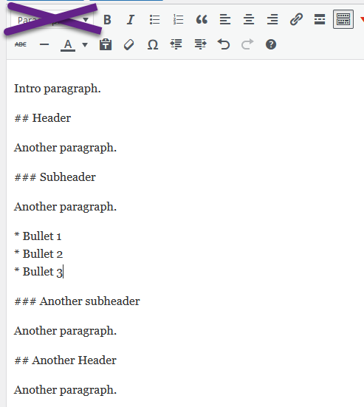
Markdown in WordPress

Slide 24

Links
Underline
Color and contrast
Skip linking full URLs
Click here 🚫 Read more 🚫
Duplicated linked text

Slide 25
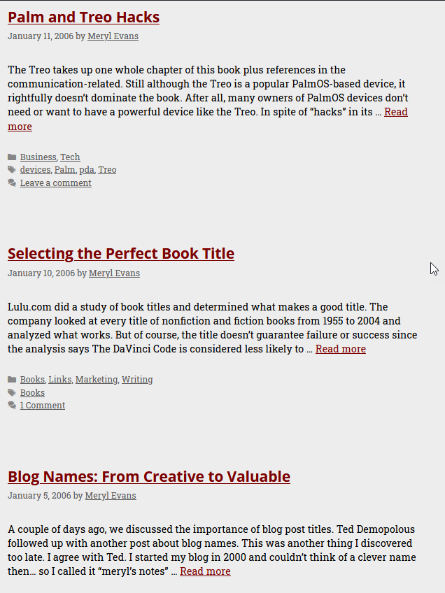
The Problem with … - Read More - Click Here - Learn More

Slide 26
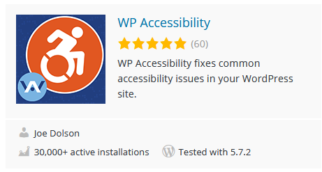
WP Accessibility Plugin
Image credit: WP Accessibility Plugin

Slide 27
Accessible Video and Audio
Skip autoplay
Add player controls
Captions
Transcripts
Audio description

Slide 28
Still Overwhelmed! WTH Do I Start?
Add accessibility plugin.
Pick one thing.
Introduction to Web Accessibility
WAI Tips and Tutorials
WebAIM intro

Slide 29
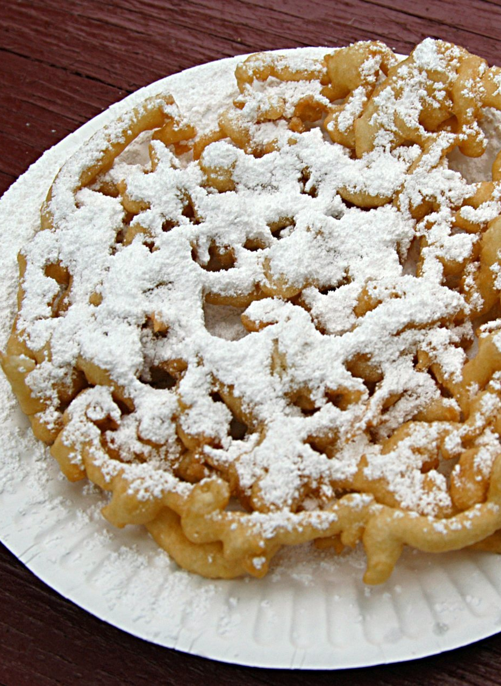
Stay Vigilant
Never one and done.
Baked-in process
Progress not perfection
Rewarding
Image credit: Wikipedia

Slide 30
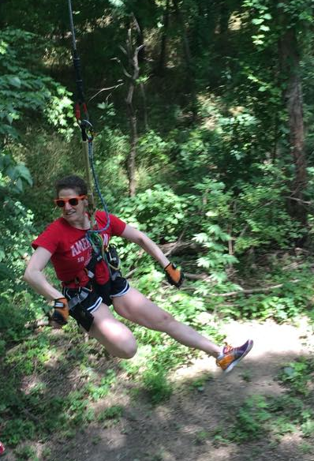
Contact Meryl
Contact and Resources
me@meryl.net
Meryl.net
Meryl.net/wcsc

