Slide 1

Get the FAQs About Captioning Videos
Meryl K. Evans
Twitter: @MerylKEvans
Meryl.net/campbay

Slide 2
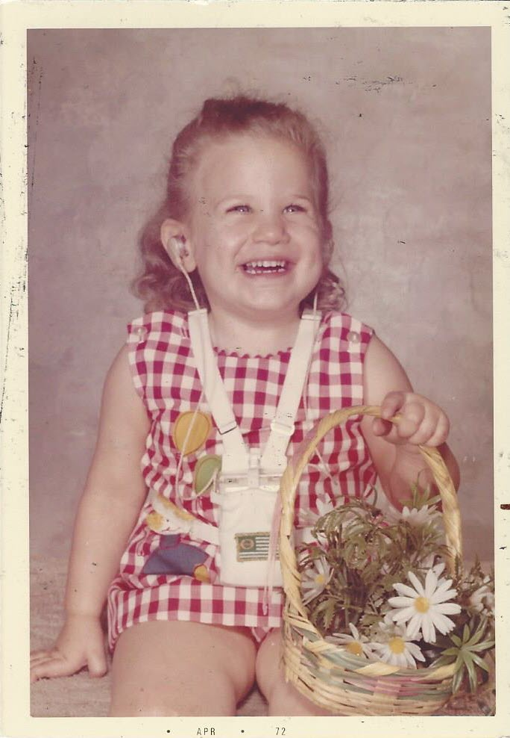
Howdy, I'm Meryl
She / her
Native Texan 🤠
Deaf since birth
Caption Pusher
Digital marketing

Slide 3
Table of Contents
Captioning FAQs
Autocraptions
Q&A

Slide 4
How do I caption a video?
DIY
Automatic Captions + Edit
Services

Slide 5
How do captions work?
Video + file
  SRT
  VTT
Time codes

Slide 6
What's the difference between open and closed captions?
Closed
  Viewer control
  Two files
Open
  Burned-in captions
  Can't turn off
  No second file

Slide 7
Should I use open captions, closed captions, or both?
Viewer control
Customization
Avoid both

Slide 8
How do I add captions online and social networks?
Closed
  Upload video
  Upload caption file
Open
  Upload video

Slide 9
How long does it take to caption a video?
It depends!
Length
Audio

Slide 10
What software or tool should I use to caption videos?
It depends! (Yup! Again!)

Slide 11
What are the best practices for captions?
DCMP's Captioning Key
10 Rules for Great Captions
  Readable
  Accurate
  Synchronized
  Size aka length
  Bottom position
  Sound
  Credits
  Voice
  Speaker ID
  Pop-in
Notes:
https://dcmp.org/learn/captioningkey

Slide 12
What are the best font and colors for captions?
Closed: default
Open
  Off-black background (#242424)
  Off-white text (#FFFFFF0)
  Plain sans-serif

Slide 13
Automatic captions aka autocraptions
Don't make sense
Embarrassing
Wrong information
Hurts brand
Views quit watching
Not equitable

Slide 14
Warning about live captioning services
Confusing messages
  Live captions
  Human captions
CART
Automatic speech recognition (ASR)
C-Print / Typewell
Notes:
ASR: Automatic speech recognition. Ai media worst than autocraptions.
Periods of no captions and riddled with errors.

Slide 15
Contact
  me@meryl.net
  @MerylKEvans (K in there!)
  linkedin.com/in/Meryl
  meryl.net/captions

Slide 16
Q&A

